Slide 1
Master Data Management, Risk and Governance
All content copyright IMCue Solutions 2008. Duplication prohibited
Notes:
Developing an Effective Road Map for Master Data Management
John Ladley
While Master Data Management certainly has a reasonable value proposition, and is relatively well understood in concept and application, many organizations have trouble specifying and sustaining a continuous high value roll out strategy. The most asked for deliverable (in this speaker’s experience) is a pragmatic, useful road map that specifies HOW the MDM efforts are to unfold. This session will cover the critical components for developing a road map and present samples of successful MDM project deliverables. Topics will be:
Components of the MDM road map
Techniques for prioritizing and segmenting the work
Sustaining elements required for any road map to MDM

Slide 2
Background
Challenges
  MDM requires GOVERNANCE
  MDM means CHANGE
  “Clean” implementations are rare
Reinforcing the challenges
  Technical projects
  Unproven technology
  Poor business requirements
  Not integrated into EA or EIM
MDM as a technology effort is not destined for success
All content copyright IMCue Solutions 2008. Duplication prohibited

Slide 3
Problem Statement
What benefits can we identify that will urge the organization towards managing information more effectively, specifically via MDM?
Notes:
At first glance, it appears that Master Data management has everything to do with data quality, and nothing to do with directly supporting business processes. However without considering the business risks that MDM should address, you may not have the backing needed to be successful. Then you can end up back where you started. Therefore viewing MDM as a risk management tool may help you embed and sustain your MDM solutions. In, MDM architectures must also reflect the business needs, and should not be based on technology-focused parameters.
This presentation will review processes to get the most from your existing or pending MDM project by ensuring that there is considerations for the business issues around risk and architecture within your “Golden Copy.” We will cover:
Understand the risks and benefits you may be overlooking
Identifying and classifying risk areas within MDM
Leveraging governance and compliance within MDM
Understand how MDM fits in with Enterprise Information Management (EIM)
Understand MDM technical architectures

Slide 4
Key Terms
Enterprise Information Management - EIM is the program that manages enterprise information asset to support the business and improve value. EIM manages the plans, policies, principles, frameworks, technologies, organizations, people and processes in an enterprise towards the goal of maximizing the investment in data and content
MDM - Authoritative, reliable foundation for data used across many applications & constituencies with goal to provide single view of truth no matter where it lies
DG - Data governance is the organization and implementation of policies, procedures, structure, roles, and responsibilities which outline and enforce rules of engagement, decision rights, and accountabilities for the effective management of information assets
John Ladley, Danette McGilvray, Anne-Marie Smith, Gwen Thomas
Architectural elements – The various pieces and products of information architectures that are designed and deployed to fulfill EIM, e.g.
  Data Warehouse
  Information architecture
  Principles, Policies
  Data quality
  Content management
  Document management

Slide 5
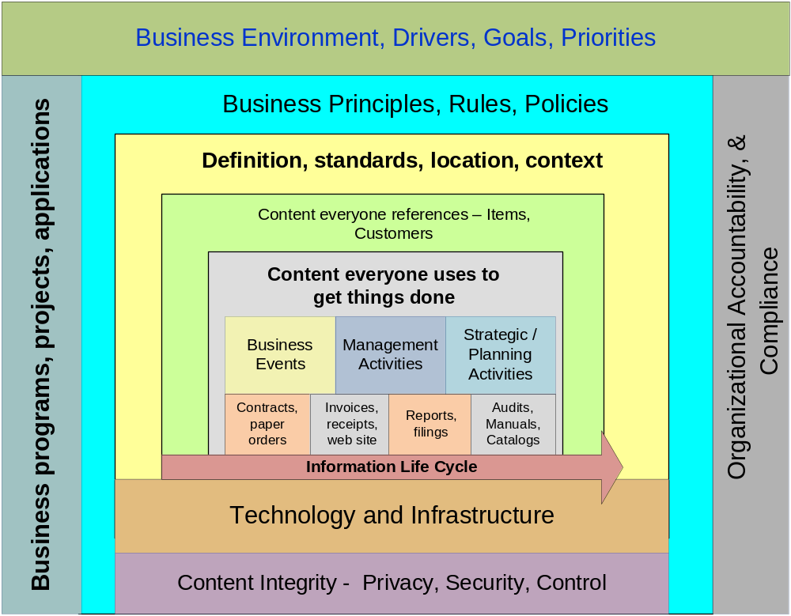
Context of EIM
Enterprise Information Architecture
Metadata
Business Data
Reference Data
Transaction Data
Operational Reporting
Analytical Reporting
Unstructured Content
Information Life Cycle
Information Life Cycle
Technology and Infrastructure
Technology and Infrastructure
Access
Access
,
,
Classification
Classification
,
,
Auditing
Auditing
,
,
Protection
Protection
Content Integrity
Content Integrity
-
-
Privacy
Privacy
,
,
Security
Security
,
,
Control
Control

Slide 6
Our Approach
Business case | Identifying and classifying risk areas within MDM Compelling scenarios
Governance | MDM Governance Compliance
Architecture | MDM and EIM Architectures
 | MDM Technical Architecture
 | Incremental roll out
Culture Change | Altering data behaviors
 | Implementing Accountability

Slide 7
Business Case
Identifying and classifying risk component
Compelling scenarios

Slide 8
The nature of EIM Business cases
Benefits from “Hard dollar”
business initiatives
(e.g. post merger economies of scale,
efficient supply chains,
effective promotions)
Managed,
Actionable
Enterprise
Information
And
Knowledge
Benefits from Efficiencies
(e.g. integration, faster information delivery)
Benefits from Risk Avoidance
(e.g. Sarbanes-Oxley Act, information privacy,
data quality, etc. )

Slide 9
* ‘Top 5’ Drivers for MDM Initiatives
Customer cross sell
Item / Product management
Compliance & regulatory reporting
Legacy system integration & augmentation
Mergers and acquisitions
Risk management?
* Source: MDM Institute, 2009

Slide 10
Example –where is the risk here?
ICA
Member Id
BIN, ICA
Apply
Approve
Disapprove
Marketing
Interim
License
ICA, Pseudo ICA?
BIN, ICA, MBR
Services
Final
Approval
Member
Information
Touch points
Member
Service
Pseudo ICA
Maintain
License
Bill
Settle
Terminate
License
Clear
ICA, ACCT RANGE
Authorize
Maintain Relationships (Parent Child)
ICA
Notify
ACCT RANGE
ACCT RANGE, BIN, ICA
Member Id

Slide 11
EIM Business Case – the Foundation Of Success
Aligns elements with business goals and objectives
Forms a quantitative foundation for metrics
Is approved by the business
In turn allows for accountability and communication to develop

Slide 12
Business Case Steps
Understand business benefits
Isolate Information usage enablers
Identify business benefits that are possible
Describe specific benefits, costs and/or “at risk” quantifiers
  Define relevant EIM benefit categories - Risk, business, project, regulatory
  Identify potential cash flows

Slide 13
Understand Business Benefits
Apply financial management management principles to information assets
Benefits are market and environment inspired and subjective components
Start with goals – expression of direction
  Goals are a response to business drivers – Environmental factors, strategies
    Example: Commoditized pricing environment
    Example: Increase market share
Drill down to objectives – Measurable aspect of a goal
  E.g. 22% market share by 2009

Slide 14
Isolate Information Usage Enablers
Where information/knowledge/data usage enables business goals / objectives
Where managed information subjects touch business functions
Identify information levers

Slide 15
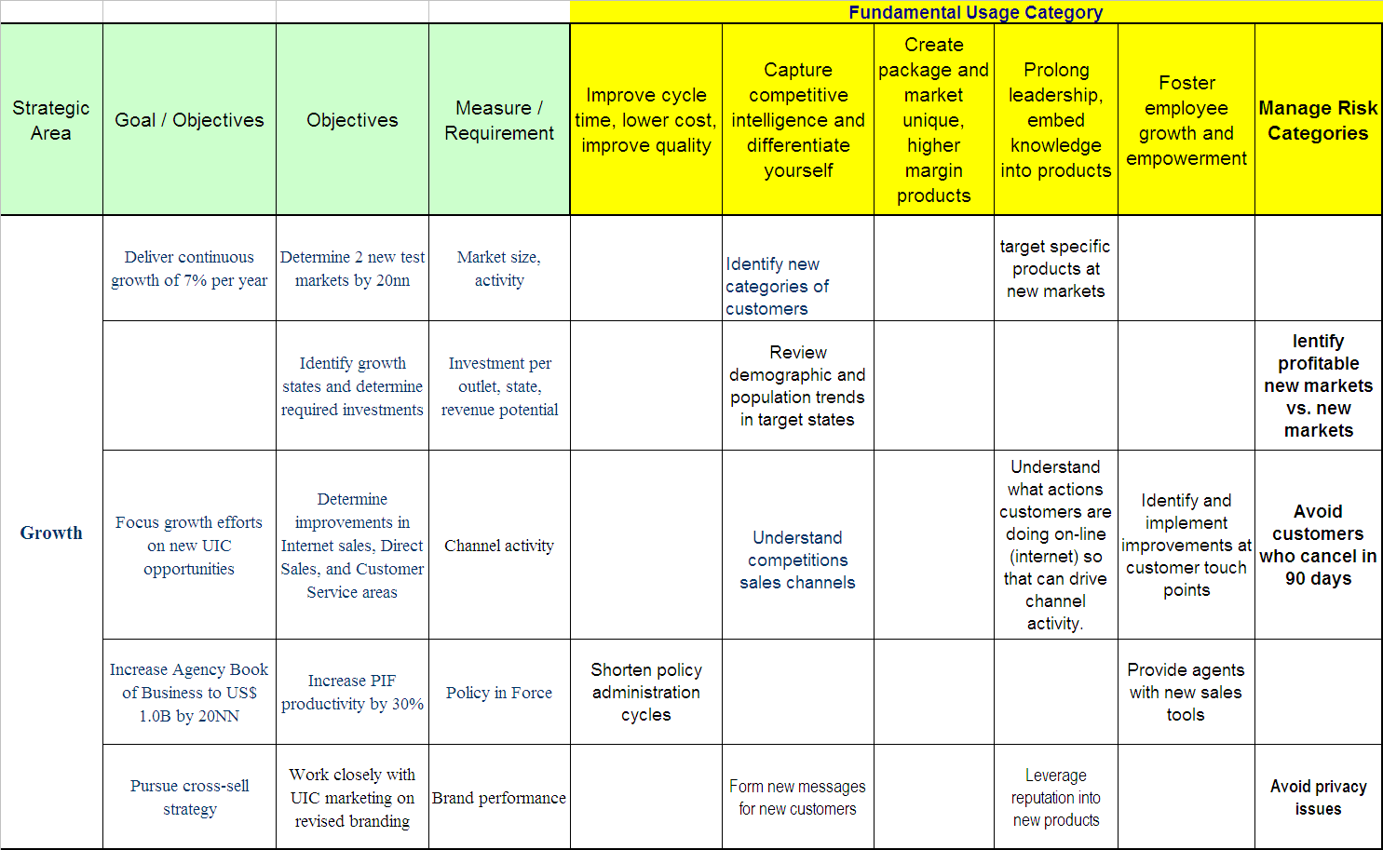
Origins of Risk Benefits for EIM

Slide 16
Why Usage Holds The Key To The Business Case For EIM
The “algebra” of R
  Where C= Create, U= Update, D = Delete, R = Read
If Value = Usage , and Usage = R, then Value = R
Therefore Information Value = R
  Then Information Costs = C + U + D
Unless information is used (read) it has no value other than the sunk cost to produce the data (transactions)
The EIM business case happens where data is used
EIM business case: R_{benefit} > C_{cost} + Ucost + Dcost + Rcost

Slide 17
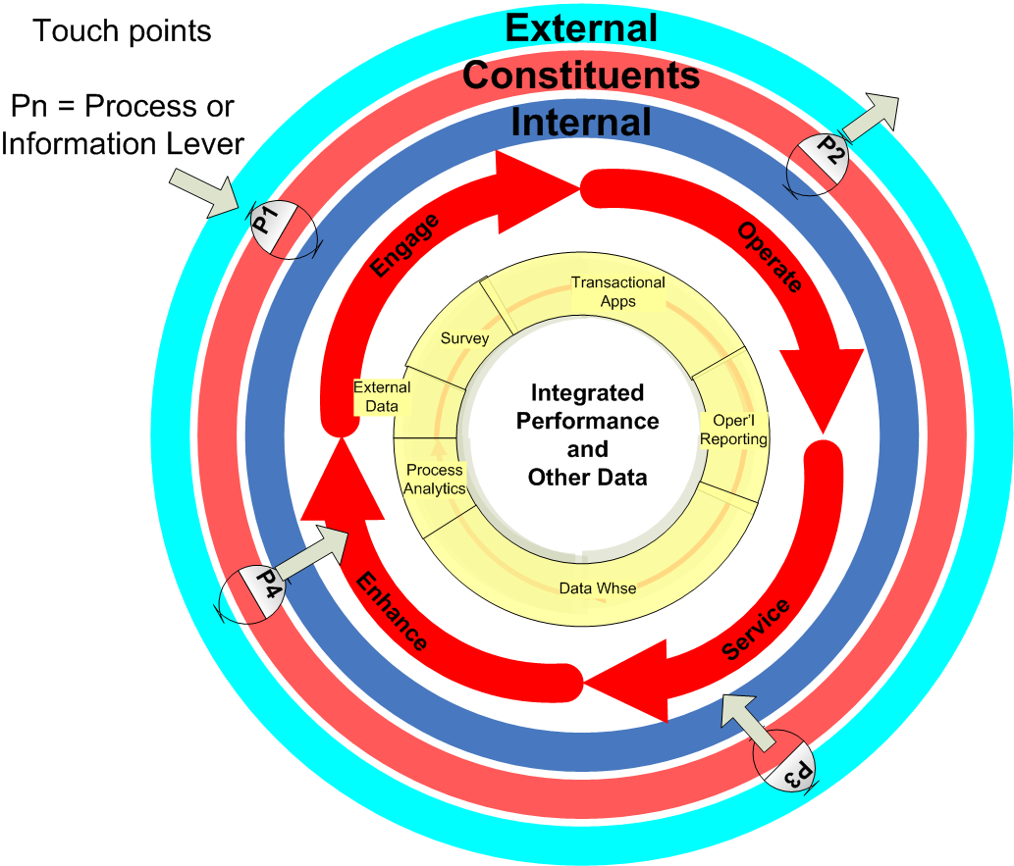
Identify Touch Points
Processes where information can be used
to improve a process, accomplish a goal, change a strategy, manage risk
Opportunities where data and information affect outcomes
  Data quality
  Consistent usage
  Timely action
  Avoid penalty
  Reduce exposure

Slide 18
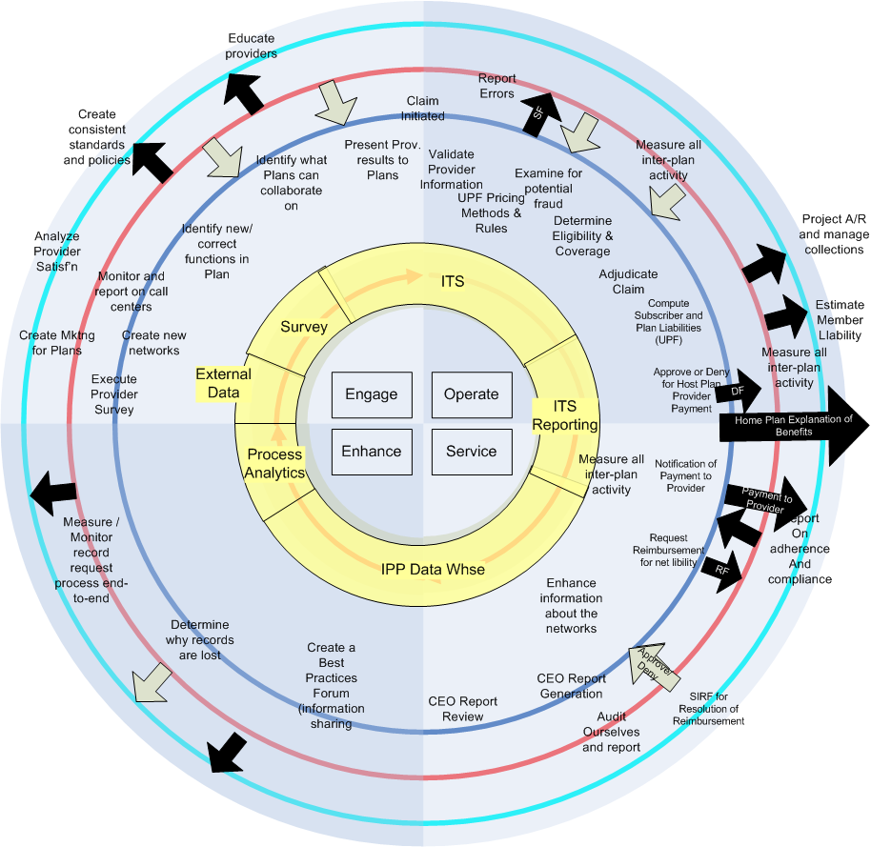
Example: Touch point risks for MDM element

Slide 19
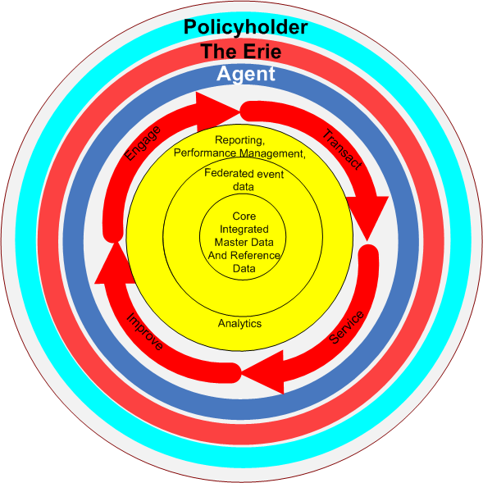
Recent example of MDM lifecycles
EIM Vision of Erie has MDM at the core
Eventually will influence business levers
Given the cross-functional nature of MDM, DG is a CRITICAL SUCCESS FACTOR
L
L
L
L
L
L
L
L
L
L
L
L
L
L
L
L
L
L
L
L
L
L
L
L
L
L
L
L
L
L
L
L
L
L
L
L
L
L
L
L
L
L
L
L
L
L
L
L
L
L
L
L
L
L
L
L
L
L
L
L
L
L
L
L
L
L
L
L
L
L
L
L
L
L
L
L
L
L
L
L
L
L
L
L
L
L
L
L
L
L
L
L
L
L
L
L
L
L
L
L
L
L
L
L
L
L
L
L
L
L
L
L
L
L
L
L
L
L
L
L
L
L
L
L
L
L
L
L
L
L
L
L
L
L
L
L
L
L
L
L
L
L
L
L
L
L
L
L
L
L
L
L
L
L
L
L
L
L
L

Slide 20
Summary for the EIM Business Case
Articulate real business drivers for EIM
  Avoid drivers like “accurate data,” “Consistent definitions”. THESE DO NOT SUPPORT A BUSINESS CASE! THEY SUPPORT THE GOVERNANCE THAT SUPPORTS THE BUSINESS CASE
  These will be derived
Isolate where usage enables goals and objectives
Business objective – e.g., Improve customer satisfaction rating 3 points
Information usage – e.g., Supply accurate customer value data to touch points
EIM goal/ objective – e.g., Ensure accuracy of customer data and calculation of customer value

Slide 21
Summary for the EIM Risk-based Business Case
Look for scenarios where:
  using data or information directly supports an aforementioned goal or objective
  increases the value of some component of the balance sheet
  Decreases the reserve, contingency or cost being accounted for
Requires formal analysis - not all of your business objectives will lend themselves to EIM inspired governance
There must be some exercise similar to this before the MDM function is established
Data that is not used has no value. If usage is not monitored, you have no idea of its value. If not used, why are you messing with it?
Remember, EIM exists to ensure value is attained

Slide 22
Leveraging Governance
MDM Governance
Compliance

Slide 23
Data Governance
MDM champions Data Governance and vice versa
Data Governance needs to be accepted
Interaction with Data Governance area needs to be constant and consistent
  Observed issues
  Business user education
  Metrics
Data Governance is mandatory for MDM
Risk-related efforts make Data Governance mandatory

Slide 24
Data Governance and Risk Management
Privacy
  Legal penalties (tip of the iceberg)
  Civil actions
  Fines
  Credibility
  Lower stock price, valuations
Fraud
  Lost credibility
  Lower stock price, valuations
Credit Risk / Exposure
  Transparency
  “R O I”
  Lower stock price, valuations
Poor business decisions
NO business decisions

Slide 25
Governance / Compliance Role in Data Quality
Define where line of authority sits
Mechanism to report problems
Support to implement scans and audits within MDM processing
Policy-based interaction with DQ area

Slide 26
Compliance
Regulatory Risks
Regulation | Impact on EIM
HIPAA | Forces encryption, rigid rules on individual record keeping
Gramm-Leach-Bliley Act | Requires accurate name. address, and opt-out processes
SEC Rule 17A-4 | Forces policies for structured and unstructured data
Sarbanes-Oxley
Section 302 | Pressures company’s chief financial officer and chief executive to ensure data is correct, and no one can "game the system" via reporting
Section 404 | Forces controls for data movement and traceability of usage
Section 409 | Forces greater awareness of business status and lowers latency of reporting
FISMA | Justification for government bodies to improve information management
BASEL II | Forced reporting and accuracy standards on large banks

Slide 27
DG Organizations - Playing with others
Data Governance
Oversight Body
  Legal
  IT
  Compliance
  DG
Legal
IT Governance
Data
Governance
Compliance
Separate area
Standardized processes, policies, rules, usage, models
Enterprise content and processes

Slide 28
Leverage COBIT
COBIT (Control Objectives for Information and related Technology) and COSO have been designated as standards to provide this guidance
COSO is for general accounting
COBIT was derived later to provide
guidance to IT functions
  Planning and Organization
  Acquisition and Implementation
  Delivery and Support
  Monitoring
Key Process 2
Key Process 1
Business Entity 2
Business Entity 1
COBIT
Framework

Slide 29
Prioritize MDM based on Governance
Tactics
  Assess data quality with an eye to errors impacts
  Document existing controls
  Define performance metrics for key
  processes at risk
  Monitor the content of all
  unstructured data by key words
  Monitor direct and indirect interactions of
  individuals that access documents,
  dialogues or e-mails in a systematic manner
  Develop dashboard reports that monitor audit
  data on all content
  Develop content retention guidelines and archival processes
  Define “Federalist” information governance road map
Localized
Info. Elements
C2 C4 M1 M4 D2
Global
information
Elements
C1
C3
M2
M5
D3

Slide 30
Summary - MDM for Compliance
Information management and architecture programs are no longer an option
Regulators already have a content management mindset, while companies….
“Federalist” and Bottom up approaches will be more suitable, this support MDM
IT may request new technologies and tools ….approach with caution!!!
  MDM products and Compliance products can be incompatible
Notes:
Struggling to master rows and columns and semantics?
Defining Unstructured information
Verifying structured conclusions
Controlling business processes
Managing Human Capital

Slide 31
Architecture
MDM and EIM
  How to fit it in
Incremental Rollout
  One bite at a time
MDM Technical Architectures
  Options

Slide 32
MDM and EIM
Enterprise Information Architecture
Metadata
Business Data
Reference
Data
MDM
BI /
Reporting
Reference Data
Transaction Data
Operational Reporting
Analytical Reporting
DQ
Remediation
Document
Mgmt
Content
Mgmt
Unstructured Content
Information Life Cycle
Information Life Cycle
Technology and Infrastructure
Technology and Infrastructure
Access
Access
,
,
Classification
Classification
,
,
Auditing
Auditing
,
,
Protection
Protection
Content Integrity
Content Integrity
-
-
Privacy
Privacy
,
,
Security
Security
,
,
Control
Control

Slide 33
Fitting MDM into the Enterprise
Assume that MDM has a strong business case
  Risk avoidance
  Business benefits
MDM is an element of EIM
How do you get EIM from MDM? (and vice versa)

Slide 34
Barriers for EIM / MDM Harmony
Which Master Data?
  Master Data overlap
  Complicated touch points
Enterprise initiatives
  ERP conflict, other packages
  Technology platform changes (SOA, SaaS, Cloud)
Normal constraints
  Business environment
  Internal culture
  Politics
  Time, money
  Chaos
All content copyright IMCue Solutions 2008. Duplication prohibited

Slide 35
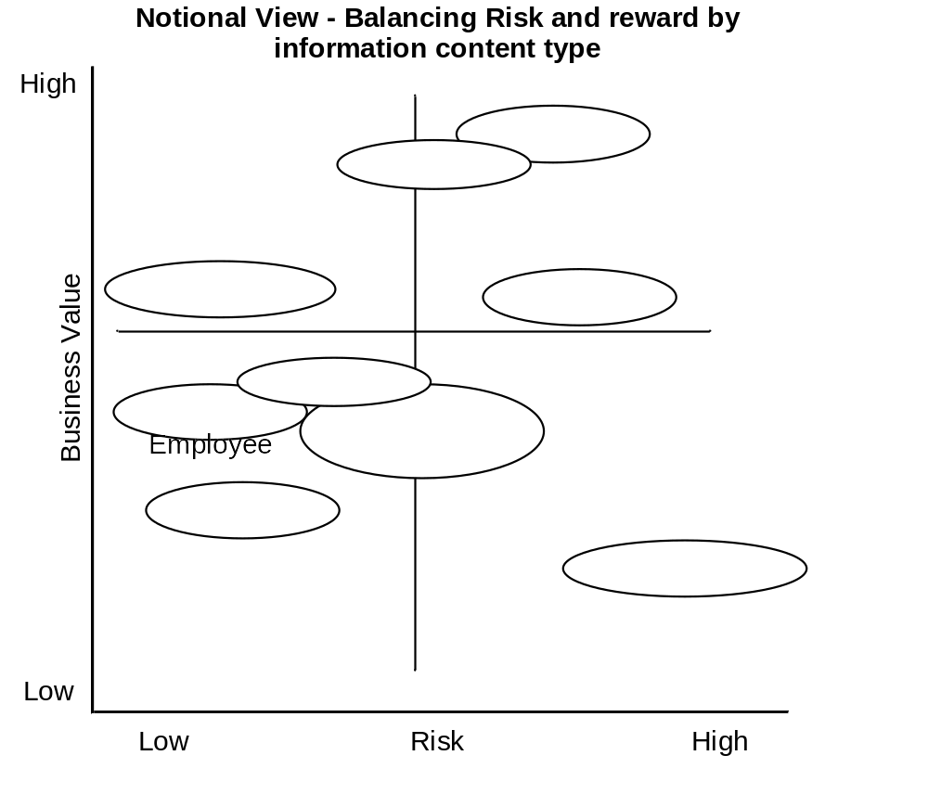
MDM candidates for EIM prioritizing
All content copyright IMCue Solutions 2008. Duplication prohibited

Slide 36
MDM candidates for EIM segmenting
Enterprise
Meaning
Dist’n
Channel
Agreements
Finance
Customer
Enterprise Context
Promotion
Supplier
Product
Facility
Local
Meaning
Local
Usage
Enterprise Usage
Enterprise
Usage
All content copyright IMCue Solutions 2008. Duplication prohibited

Slide 37
Techniques for segmenting
Segmenting (breaking up the work)
  Which Master Data Area?
  Which business functions?
Align segments with business needs and practical knowledge
All content copyright IMCue Solutions 2008. Duplication prohibited

Slide 38
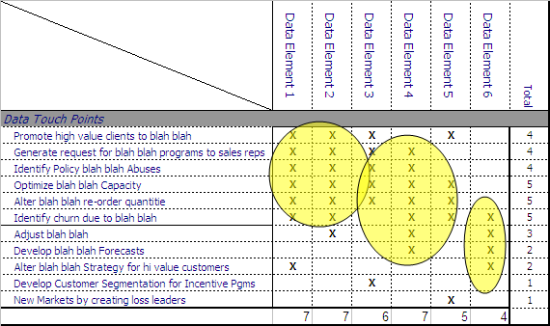
MDM Techniques for EIM alignment
All content copyright IMCue Solutions 2008. Duplication prohibited

Slide 39
EIM / MDM Road Maps
Components of the MDM road map
  A Table of Contents
Techniques for creating “what to do”
  Segmentation
  Prioritization
  Alignment

Slide 40
Components of the MDM road map – Almost identical to EIM
Scope
Business objectives
Target Data architecture
  Data models
  Information Value Chain
  Data quality standards
Technology Solution
Segmentation and Alignment
Incremental Projects
  Business projects
    Risk based
    Business goal based
  Governance projects
  Support/infrastructure projects
    Discovery
    Codes / Reference
    Migrations
    Clean ups
  Roll out strategy
Sustaining Plan
  Governance
    Organization
    Principles
    Policies
  Culture change management
All content copyright IMCue Solutions 2008. Duplication prohibited

Slide 41
Techniques for prioritizing
Prioritizing
  Which data elements?
  What then within the area chosen?
What does business need first?
What can be done first?
  Influencers
    Regulatory
    direct financial benefit, indirect financial benefit
    business agility, performance
    competitiveness
    ease of implementation
All content copyright IMCue Solutions 2008. Duplication prohibited

Slide 42
Aligning segments to needs
Once the Master data area is known, then what?
Identify initiatives / projects within the master data area via appropriate analysis
  Clustering
  Affinity
  Politics
All content copyright IMCue Solutions 2008. Duplication prohibited

Slide 43
Incremental Roll Out
Reduce the initiatives to projects that can be accomplished in 6 – 9 month time frames
Project should be categorized
  Business projects
  Governance projects
  Support/infrastructure projects
    Discovery
    Codes
    Migrations
    Clean ups
Roll out strategy should CLEARLY show how projects will build to the final result
All content copyright IMCue Solutions 2008. Duplication prohibited

Slide 44
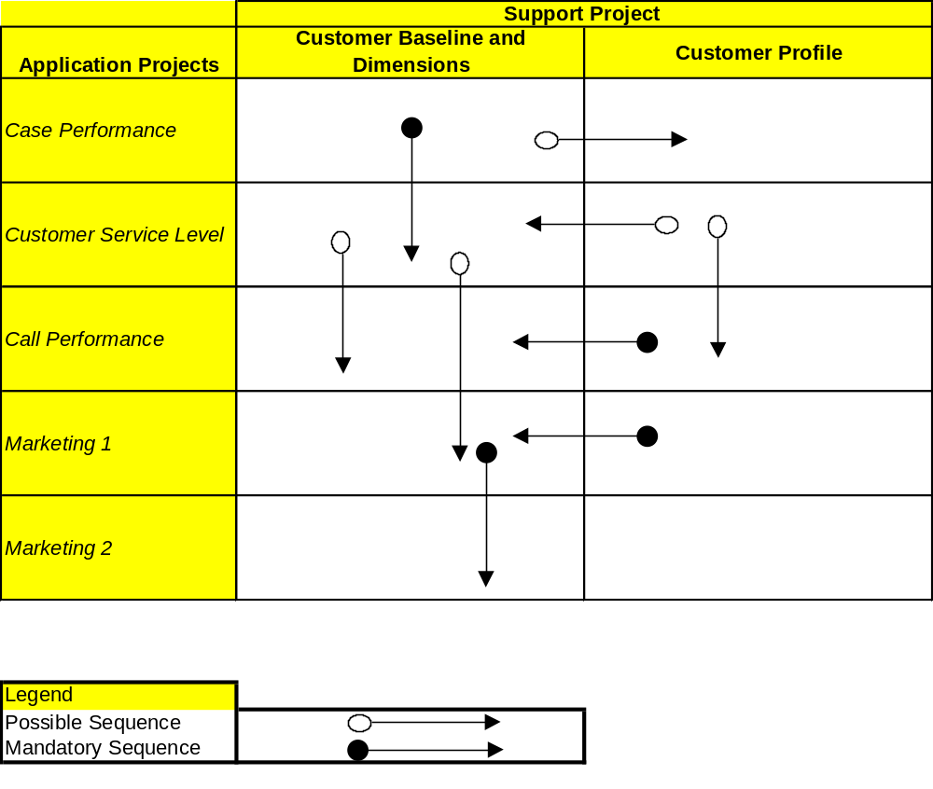
Road Map Sample 1- Customer MDM>EIM
All content copyright IMCue Solutions 2008. Duplication prohibited

Slide 45
Road Map Sample 2 – Client facing EIM
Reverse Engineering
Forward Engineering
1
3
Meta Data Layer
Semantics Measures Data Assets Work Flow Rules
Physical
Databases
Master Area
Abstraction
Processes
“Mapping”
Views
Apps
Current Physical
Views
1
Future Logical
Views
Future Physical
DBMS
Future
Apps
App1
App2
App3
App4
App5
App6
App7
Appn..
2
2
2
3
1
3
Info. Management Processes
Synchronize to other data
2
3
Access layer - DW,ODS, Services etc.
All content copyright IMCue Solutions 2008. Duplication prohibited

Slide 46
Road map sample 3 - The “notional gantt”
Data Quality
DW/BI/ IM Applications
1
Support Project
Data Gov.
IM Orientation
IM Orientation
IM Orientation
IM Orientation
IM Orientation
IM Training
IM Training
IM Training
IM Training
IM Training
2
Product DQ I
Item / Cost MDM
Item / Cost DQ II
Product DQ I
Item / Product MDM
Cust DQ I
Item / Product MDM
Item / Cost MDM
Product Profitability
Supply Chain Effectiveness
Inventory Activity
Drawing Content Mgmt
Shop Order Management
3
2009
2010
2011
2012
2013
Sales Management
Call Center Mgmt
Maintenance Management
Customer Service Mgmt
Customer Management
Call Center Mgmt
Cost Management
Revenue/Product Mgmt
Sales Forecasting
Expense Management
Cost Management
4
Data Gov. I
Data Gov. II
Data Gov. III
Data Gov IV
Data Gov. I
Data Gov. II
5
SDLC Roll Out
Work Flow
Corp. DNA
Code Decode II
All content copyright IMCue Solutions 2008. Duplication prohibited

Slide 47
Ideal MDM approach
Initiate and
Proceed
MDM
Discovery
&
Bus. Processes
MDM
Design
MDM
Technology
MDM
Road Map
MDM/ESC
Business
Process
Design
MDM/IVC
Business
Process
Design
MDM
Project 1
Start
All content copyright IMCue Solutions 2008. Duplication prohibited

Slide 48
“Practical” MDM Approach
Initiate and
Proceed
MDM
Discovery
&
Bus. Processes
MDM
Discovery
&
Bus. Processes
MDM
Design
MDM
Technology
MDM
Road Map
MDM/ESC
Business
Process
Design
MDM/IVC
Business
Process
Design
MDM
Project 1
Start
Tactical
Clean up
MDM
Project 2
Start
MDM
Project N
Start
All content copyright IMCue Solutions 2008. Duplication prohibited

Slide 49
MDM Technical Options
Hub Style
  Registry
  Cross walk
Hybrid
  Managed Redundancy
  Central synch point
Centralized
  Services based
  Semantic

Slide 50
*MDM Topologies- MDM Institute
IMPLEMENTATION STYLE | DESCRIPTION
External (Service Provider) | Database marketing providers Data service providers Service bureaus
Persistent (Database) | Master customer information file/database Operational data store/active data warehouse Relational DBMS + Extract-Transform-Load (ETL) + Data Quality (DQ)
Registry (Virtual) | Metadata layer + distributed query (enterprise information integration or EII) Enterprise application integration (EAI) Portal
Composite (Hybrid) | Ability to fine-tune performance & availability by altering amount of master data persisted XML, web services, service-oriented architecture (SOA)
“Chernobyl” | Encapsulate legacy applications
Composite/Hybrid is majority architectural preference;
Registry/Virtual 2nd choice

Slide 51
Hub Style
Registry – “Keys” only in the Hub
Cross walk - Translation occurs in the Hub
Multi-entity hub capabilities
SOA/shared services architecture with evolution to “process hubs”
Sophisticated hierarchy management
High-performance identity management
Data governance-ready framework
MASTER
DATA
APPLICATIONS
MASTER
DATA
SEARCH
MASTER
DATA
MODELING
MDM
MASTER
DATA PREPAR-ATION
MASTER
DATA
GOVERNANCE
MASTER
DATA
MOVEMENT

Slide 52
Hybrid
Legacy App A
Legacy App B
Managed Redundancy
  Containers represent applications
  Central synch point OR
  Services used for synchronization
Legacy App A
Legacy App B
MASTER
DATA
APPLICATIONS
MASTER
DATA
SEARCH
MASTER
DATA
MODELING
MDM
MASTER
DATA PREPAR-ATION
MASTER
DATA
GOVERNANCE
MASTER
DATA
MOVEMENT
New App A
New App A
Federated Hub

Slide 53
Centralized
Services based
  All applications use services to get and update their own containers
Semantic
  Contextual use – ontologies (Brand new)
Brute force
  Uses “brute force” ETL or scripts, or procedural code
  Requires signals to enact “push”
  Batch or asynchronous messages
  Common during CRM era
Internal
Sources
(ASM/CFI,
RIMS/ IMAP,
JD Edwards
Client Master Build and Linkage
External
Sources
(Axciom
Experion)
Client
Master
Hierarchy &Data
(New apps)
ERM,
nForm,
“Push”
good
client
data to ERM
and other
apps

Slide 54
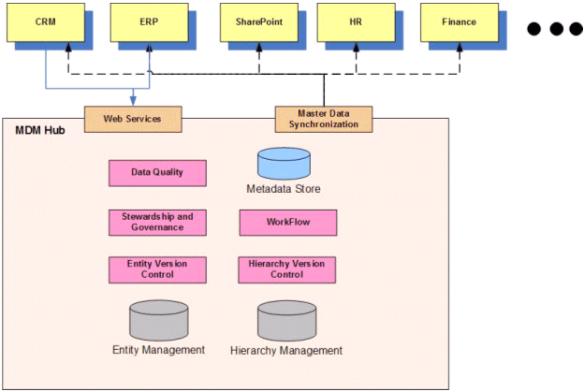
Another view of a Hub
Microsoft, MDM Hub Architecture 2007, (source via Wikipedia)

Slide 55
MDM – Cross walked, Abstraction hybrid
Reverse Engineering
Forward Engineering
1
3
Membership Meta Data Layer
Semantics Measures Data Assets Work Flow Rules
Physical
Databases
Member
Id
Abstraction
Processes
“Mapping”
Views
Apps
Current Physical
Views
1
Future Logical
Views
Future Physical
DBMS
Future
Apps
FIM
MPS
SAM
MPI/LMS
EMPI
MPS
MPI
RPPS
2
2
2
3
1
3
EMPI synchronize to other Member data
2
3
Other Uses of Member – DW,Services etc.

Slide 56
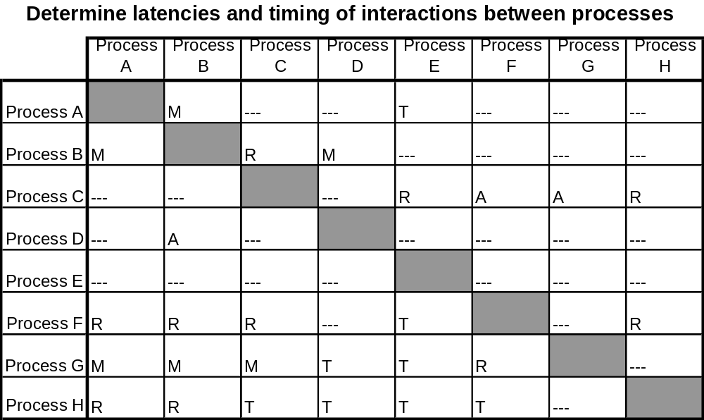
How to determine
Scenario basis, Business process models
M = Message
A = Aggregate
R = Replicate
T = Transform

Slide 57
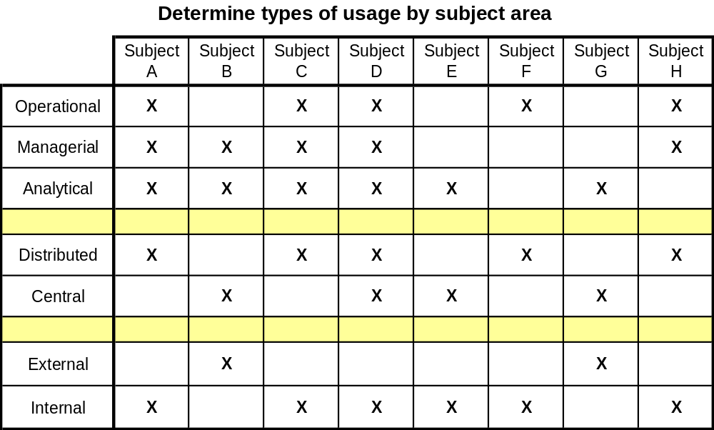
How to determine
Interaction basis, Use of data and synchronization needs

Slide 58
Culture Change
Altering behaviors
Implementing Accountability

Slide 59
Formal Change Management
“The transforming of the organization so it is aligned with the execution of a chosen corporate business strategy. It is the management of the human element in a large-scale change project…” Gartner Group
The bridge between implementing data governance and the organization realizing the benefits associated with the change
Notes:
More simply put – it’s paying attention to how people are reacting to a change and putting some structure around how you deal with it.
Flip chart responses from the audience: uncomfortable, incompetent, stressed, anxious, defensive or excited, creative, rejuvenated, fearful
Need DG examples of possible disruptions: no longer easy access to data, processes and oversight in place, compliance monitored
Why would data governance cause these kinds of reactions?
Point is, be prepared for fear and resistance – it will happen

Slide 60
Culture change
How do people typically react to change?
Definition – Culture is how organizations do things
Governance / MDM / EIM changes culture – period
Risk driven MDM has a change management edge, but………
Therefore….
  Still should assess culture as it applies to using MDM
  Define a detailed strategy to manage the culture and business process change
  Deploy iterative, consistent, formal MDM communication mechanisms
    Educate and inform the organization of value of MDM
    Keep participation levels high
    Increase stakeholder commitment
All content copyright IMCue Solutions 2008. Duplication prohibited

Slide 61
Specific issues of change with MDM
Loss of identity and their familiar world
Disorienting experience of the transition between the old and the new
Weak/no sponsorship by executive leaders and managers
Overloaded with current responsibilities
No answer to WIIFM
No involvement in the crafting the solution
Information maturity / Culture
Urgency of business drivers and environment
Notes:
Other work and personal issues
Each individual’s capacity to handle change
Change fatigue
How well an organization has handled changes in the past
Effective support such as:
Clear vision for the change and a plan to drive it
Strong and visible leadership
Early (and often) communication to affected stakeholders to educate and engage them
in the process
Opportunities for and responsiveness to feedback
Effective education when needed
Measurement of results
Aligned policies/practices, rewards and recognition, organization
Information maturity / Culture
Political strength of Applications
Pervasiveness of information leverage
Existing federation of IM components
Strength of functional silos
Existing governance
Business’ view of data/information
Legal / compliance environment
Urgency of business drivers and environment
Role of IT in the eyes of the CEO

Slide 62
Altering Behaviors
Position Data Governance
  Identification of responsibility of execution
  Identification of accountability
  Dedicated governance
  Traditional information management governance
  Ownership definition, training and guidelines
  Stewardship definition, training and guidelines
Position MDM Organization
  PMO-type activities
  Data quality
  Process re-definition
  Architecture and technology governance
  Position Business Areas
    New Processes
    New Accountability
Address Resistance
All content copyright IMCue Solutions 2008. Duplication prohibited

Slide 63
Position Data Governance
Risk based MDM means:
  Multi-dimensional ownership
  Everyone is a “steward”
Accountability roles defined for:
  Department level managers
  MDM Data Governance Committees
  Organization :Leadership

Slide 64
Position MDM Organization
Business processes
  Process Accountability
  Training and Orientation
  Risk Measurement
Data Ownership
  Accountable Management
  Response to Risk Measurement
  Data Issue Mitigation

Slide 65
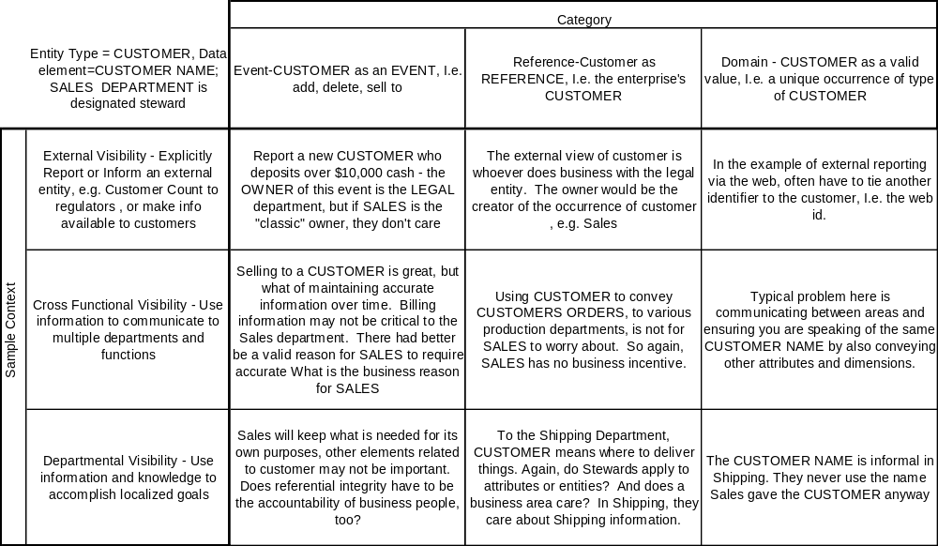
Stewardship Sample - MDM
Traditional concepts are replaced by multi-dimensional model – a steward for each cell!

Slide 66
Address Resistance
Trying to outlast the changes: bargaining for exemption from new policies or processes
Reduction in productivity and missed deadlines
Going back to the old way of doing things
Lack of attendance in project status meetings and events, or training
Higher absenteeism
Open expression of negative emotion
For executives:
  No visible sponsorship of the changes; no open endorsements
  Refusal or reluctance to provide needed resources and/or information
  Repeatedly canceling or refusing to attend critical meetings

Slide 67
Symptoms-Risk Managed Environment
“Why can’t I call (insert name here) and get that Product entered manually?
Our reports are correct – prove us wrong.
“We don’t need more rules”
“…but you said I own the data”
“We are used to the data in that format”
We will disrupt customer service
“Slowing down my project”

Slide 68
Resistance is Normal
TIME
Current State
**(Endings)
Desired State
(New Beginnings)
Denial
Shock
Anger
Resistance
Anxiety
Loss
Transition
State
(Neutral Zone)
Commitment
Goal Setting
Setting Priorities
Exploration
Acceptance
Acceptance and Buy-in
Confusion
Resignation
Fear
Frustration
** William Bridges, Managing Transitions

Slide 69
Implementing Accountability
Governance - Organization charts
  Based on RACI analysis of core functions
WIIFM
Modified Job Descriptions
Modified Performance Objectives
All content copyright IMCue Solutions 2008. Duplication prohibited

Slide 70
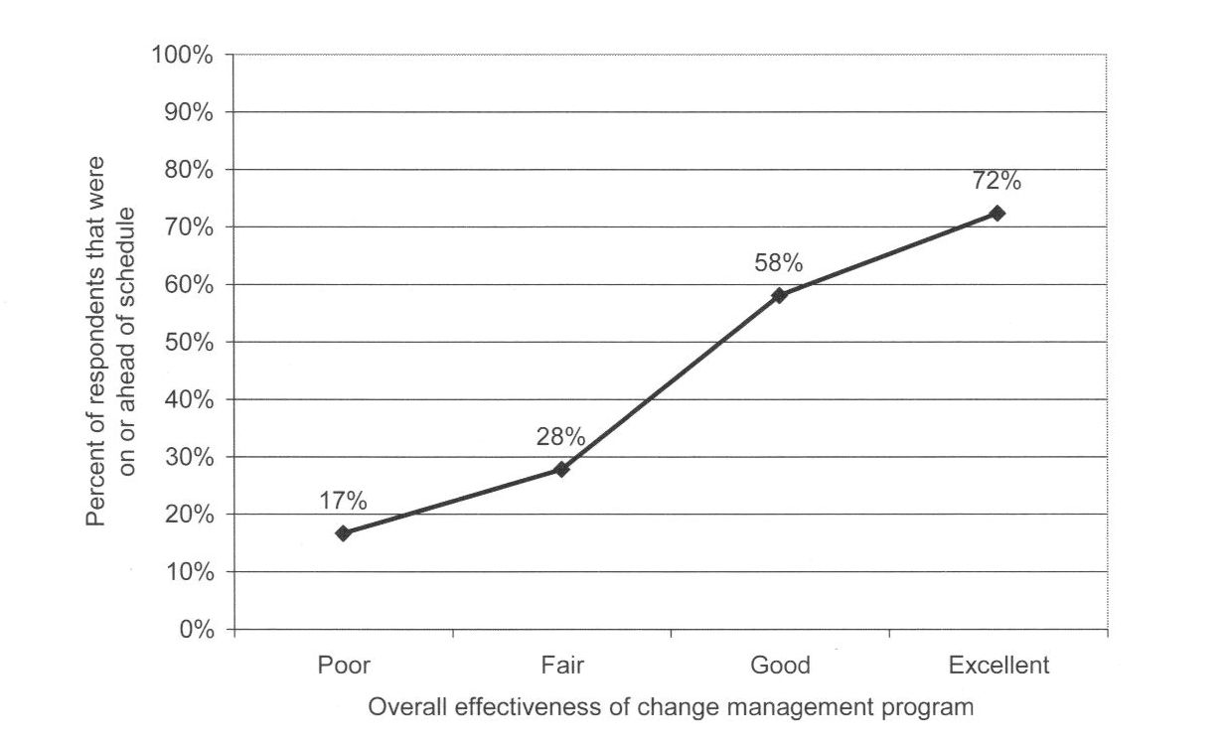
Change Management Impact
Significant correlation between change management effectiveness stay on or ahead of schedule
**Information courtesy of Prosci: 2007 Best Practices in Change Management
Benchmarking Report
Notes:
Similar slide, but addresses the ability to stay on schedule: 72% of those who felt they had a strong CM program were more likely to be on or ahead of schedule versus 17% with those who had a poor or no program.

Slide 71
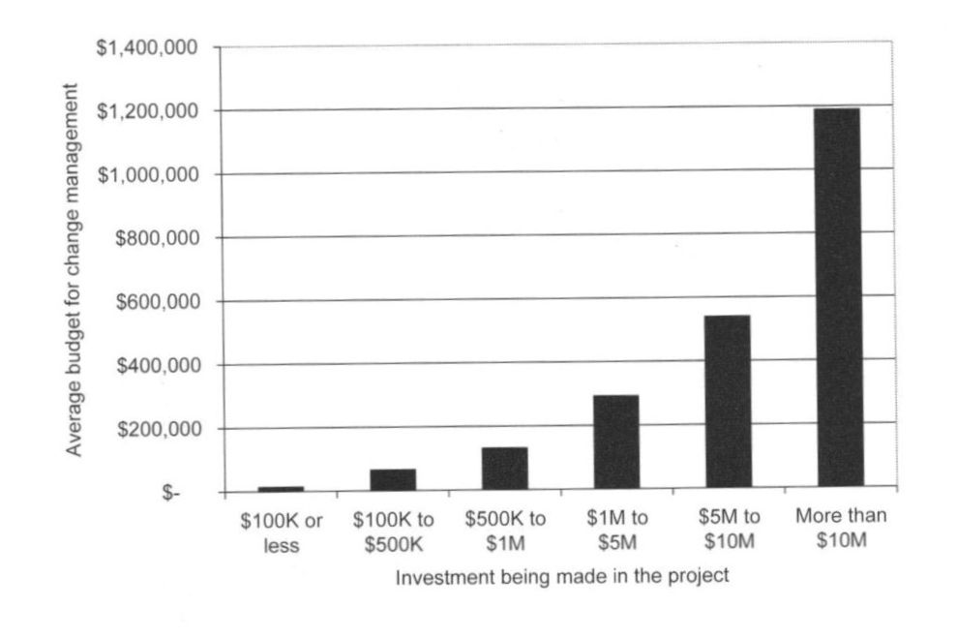
Change Management Budget
Only 16% of the participants reported that they did not have budget set aside specifically for change management
**Information courtesy of Prosci: 2007 Best Practices in Change Management
Benchmarking Report

Slide 72
Key - Focus on Ability to Execute
Know People and the Business
  The MDM requirement arose for a reason
Insist on Realism
  Do not accept “someday” answers
  Technology framework must be workable
  Demand performance from vendors and deployment staff
Set Clear Goals and Priorities
  WIIFM is way more relevant than you think
  Measure progress explicitly
Follow through
  Walk the talk
Reward the doers
  Incentives are crucial
Expand people capabilities
  Allow people who embrace challenge to grow
Know yourself
  Get help – this is not something you do everyday
Bossidy and Charan, Executions, The Discipline of Getting Things Done,
Crown Business Publications, NY NY 2002
Notes:
Know People and the Business – As a leader accountable to sustaining EIA you want to understand what the business needs to accomplish, and the ability of your team to meet business objectives. This translates to the following actions:
Talk to the change agents and important individuals directly. Point blank ask them about prior performance and accomplishments. This means do not send the business analysts, or data architects. Information executives need to be intimately involved.
Talk to applications development and get their candid opinions. Make sure they understand the level of support that EIA has (hopefully you have it!)
Assess key individuals who will be touched by governance in the context of a threat analysis. This means a version of the old political saw of “keep your friends close, and enemies closer.”
Understand ALL the players – HR, Shadow IT, etc.
Insist on Realism – Few CEO’s tolerate sugarcoating. Likewise, as projects roll out under IM governance, make sure that overly optimistic results are not habitual. For example there will be a tendency to hide issues with data governance and not report the issues and problems with semantics. However these are lessons and steps all EIM functions must go through. Therefore make sure people are comfortable talking about mistakes and challenges. In addition, make sure that all projects executed to implement IM contain real business benefits. Avoid infrastructure-only projects.
Set Clear Goals and Priorities – Focus is a key to a CEO’s success. The executive team and their subordinates need to know where to concentrate efforts and what progress is being made. To the EIA manager, this means “do not boil the ocean.” The road map to implementing governance must be incremental. The planning and rigid adherence to interim targets is mandatory. Make sure business benefits are met, measured and advertised.
Follow through – Once the early projects get started, a common error is for the IM manager to move on to new challenges. Do not forget to hold rigorous status meetings, where metrics of progress are reviewed. (Not status meetings where everyone says how well they are doing.)
When conflicts arise do not hesitate to throw warring parties into same room and send them out with a decision. Reach out to business sponsors and leaders with success and ask for advice.
Reward the doers – Set your incentives for rewarding progress ahead of time and make them meaningful. Of course, this means that you have metrics in place, and also means there are negative consequences for poor results as well.
Expand people capabilities – “Go getters” and people who “get it” will be easy to identify. Make sure they get development where needed. Conversely, you will have staff that join IM but quickly, and obviously, struggle excessively with the abstract-to-concrete processes. They need to be directed to others areas.
Know yourself - if not strong in an area, e.g. conflict, then find people who can supplement you. IF you are solid in conflict resolution, but weak in metrics and numbers analysis, get an assistant who loves gathering project data and analyzing surveys
[1] Bossidy and Charan, Executions, The Discipline of Getting Things Done, Crown Business Publications, NY NY 2002

Slide 73
Human Dynamics Context
How human beings function individually and collectively
Mechanisms affecting change management and transformation
EIM SHOULD BE VIEWED AS SIGNIFICANT TRANSFORMATION FOR MOST ORGANIZATIONS

Slide 74
Summary
MDM an be reinforced by examining all Risk areas
A Risk-based MDM effort is also a keystone EIM effort
MDM and Data Governance must deploy together, but Compliance makes that easier
MDM is a process/program with the same requirements as any other process change effort

Slide 75
Building Value Through Information Asset Management
jladley@imcue.com
314-422-9076

